Slide 1
Avoiding the Pitfalls of Disaster Work
It’s THEIR DISASTER
Don’t Make it Yours!
AssP Meeting 12/15/2020
Notes:
For most workers who go to do disaster work They are able to handle the stress disaster work imparts. For some, it becomes a numbing “deer in the headlights” experience. Katrina experience with nurse assigned as the head nurse, gave her orders and she froze! Still others were woefully unprepared for the austere environment. Bivowaced in an abandoned skating rink for an event of over 1 million visitors – operation sail in Boston. They heard Boston, not disaster!

Slide 2
Concept for Pre / Post Disaster Worker Training used with permission from
The Mount Sinai Selikoff Centers for Occupational Health

Slide 3
Objectives
Explain what motivates disaster workers.
Answer the question: What did I get myself into?
Discuss common pitfalls that put the worker at risk
Review how to get ready so as not to be part of the problem
Discuss why workers get sent home.
Explain the importance of working within the ICS framework

Slide 4
So What Is A Disaster Anyway?
A disaster is a natural or human-made event resulting in such severe physical damage, ecological destruction, loss of human lives, and/or deterioration of health and health services that it threatens the survival of a community and requires an extraordinary response from outside the affected region
Notes:
The size is not necessarily the defining parameter. In a rural setting a gas main break that causes a series of explosions in a three sq mile area could overwhelm the fire police and EMS. Response from outside the region would be required.

Slide 5
Simply Put----
A Disaster is anytime the local resources are overwhelmed and no longer capable of maintaining services to the affected area.
All Disasters begin and end locally!

Slide 6
Why We Do What We Do
Altruism (the belief in, practice or behavior that benefits another, often at its own expense.)
Competency (we are good at what we do!)
Personal Gratification
Pay It Forward Attitude
We were Volunteered
Notes:
All these admirable qualities do not necessarily mean that the person who posses them is prepared to handle the tasks and stressors of disaster work. But if you were to interview these workers, you might find that they offer these qualities as their qualifications. I submit that our screening for volunteers to do the disaster work look more closely at the emotional, mental and physical stability and stamina once we have been satisfied that these workers have the qualities of a dedicated worker.

Slide 7
Why Workers Get Sent Home
“Disaster cleanup creates a situation in which laborers and construction workers are at significant risk of injury due to their inexperience at disasters, lack of training and / or preparedness”
APHA - Response to Disasters Protection of Rescue and Recovery Workers 11/8/2006
Workers show up dependent upon resources that are not there!
Lack of adequate training and enforcement of existing standards and regulations
Workers self deploy without benefit of preparedness
Workers free lancing
Notes:
For without an adequate screening and training program, workers will get sent home. But before they are sent home, they consume resources meant for the disaster and it’s victims, distract from the mission and damage the credibility of the organization they represent. The NDMS system learned the lesson the hard way, most notably in the response to the Haiti hurricane Matthew disaster. Members of teams sent for relief work had to be airlifted back to the states for medical care.

Slide 8
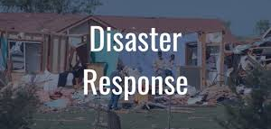
AVOIDING THE PITFALLS
Notes:
So disaster response is more than good intentions and self interest. Let’s look further into the dynamics of a response.

Slide 9
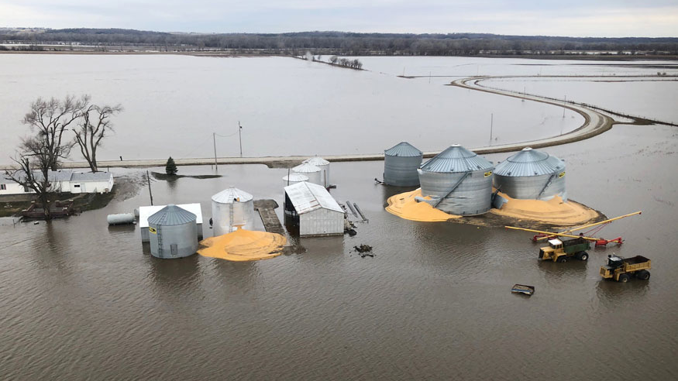
So… What Did I Get Myself Into!
Notes:
If you are not prepared, your first reaction to seeing your work area is not” Let’s get to work…. But What did I get myself into!. At the site is the wrong time to ask that question, which should have been asked prior to leaving home base.

Slide 10
YOU MAKE THE CHOICE
Deploying without adequate sit rep info: OR ----
Relying on components of the infrastructure to be intact OR ----
Assuming: food will be available, communications will be functional, housing will be provided OR ----
Notes:
So that you do not have to ask that question (what did I get myself into) you need to get a realistic take on what it is you are going to face. Plan Prepare Ready Go

Slide 11
Oops! You Made The Wrong Choice!
Make the wrong choice and you threaten Maslow’s Hierarchy of Needs. This in turn supports a Scarcity Mentality (more on this later)
Notes:
In any disaster where there is an austere environment, you are reminded of the Maslow’s Hierarchy of Needs: physiological needs,(food, & shelter) safety needs, (security & threat protections) love and belonging needs, (part of the solution, not the problem) esteem needs, (self worth) and self-actualization needs. (Being in control). Disasters probably accentuate these needs profoundly. Particularly if one is not prepared for what they got themselves into.

Slide 12
Making the right choice How and What to get ready
Medical clearance (fit for duty)
Plan for what is expected, then add the unexpected
Pack for success
Leave home with a sense of calm – taking care of business
Get a Sit-Rep before you leave
Who ya gonna call?
Notes:
Preparedness is actually two steps Getting prepared and getting ready. You can’t be ready if you are not prepared. Let’s look at each of these preparedness steps which when executed correctly will lead you to be ready.

Slide 13
Medical Clearance – Fitness for Duty
Underlying medical conditions vis-a-vie conditions at the disaster site
Current medications
Allergies
Recent or planned surgeries
Respiratory clearance and ability to use / wear PPE
Preventative strategies – vaccines, health teaching
Notes:
Some medical conditions do not fair so well in certain conditions. Some conditions require more than just a healthy being, but one who can don PPE without detriment. Some exposures at the site will require pre deployment prophylaxis – such as hepatitis A and B vaccine, flu shots and tetanus. Recent surgeries that still have post surgical follow ups scheduled are a reason not to deploy on this particular mission. Medications that require refrigeration or medical devices that require power may not be able to be used on certain deployments due to the damage to the infrastructures power.

Slide 14
Plan for what is expected, then add the unexpected!
Injury? Self - Victims
Stress? Emotional – Physical - Mental
Violence ?
Long Hrs ?
Chaos !
Conflicting Communications
Notes:
Planning to handle violence at the disaster site can be done through several avenues. Cognitive rehearsal, information gathering of the area and current conditions, getting real time sit reps, talking to veterans, reviewing protocols, self assessments of skill sets, etc. NIOSH has identified 4 typologies of violence (stranger, customer, staff, relative) add a 5th – self inflicted violence - suicide

Slide 15
Pack For Success!
Take What You Need
Take What You Can Carry
Take What You Can Use
Notes:
If you don’t take it and you planned on buying one there, the bad news is that Walmart is closed! If you take it and you don’t need it, the bad news is you took up space for something you could use! If you need it and you take it but you can’t use it why did you bring it in the first place! (electric can opener!)

Slide 16
Leave Home With A Sense of Calm
Notes:
Sense of calm comes with preparedness and readiness

Slide 17
Put Affairs In Order
Pay Bills In Advance
Obtain supply of Medications needed
Arrange for mail, home security, pets and plants
Contact information
Notify work, friends and family

Slide 18
Get a Current Sit-Rep
Location of disaster site you will be deployed to
Conditions at the site
Hazard assessment
Special considerations
Climate & Weather
Command and Control Structure
http://www.disastercenter.com/FEMA%20Daily%20Situation%20Report%20Archive%202020.html
Notes:
The Sit Rep can be obtained from the requesting agency or organization you will interface with at the site. Or it can be obtained from the FEMA website http://www.disastercenter.com/FEMA%20Daily%20Situation%20Report%20Archive%202020.html

Slide 19
Who Ya Gonna Call?!
Who is in charge? Is it YOU!
ICS clarifies this for you
Where do you fit in on the ICS framework?
How about home contacts, work contacts, emergency contacts?

Slide 20
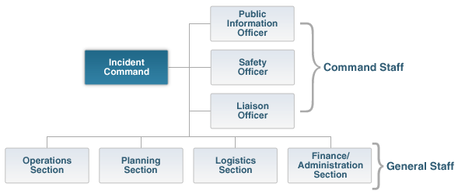
The Importance of ics at a disaster ….
Order out of chaos!
Notes:
You fit into the response picture, the question is where and how! ICS has the answer. Common terminology, span of control, chain of command.

Slide 21
Function Follows Forms
Incident Management Forms (ICS)
https://training.fema.gov/icsresource/icsforms.aspx
Notes:
Look at some of these forms. They give you an organized approach to the tasks at hand.

Slide 22
You Are First To Arrive Here!
NOW WHAT ?
Notes:
First on scene and you are past the “What did I get myself into!” thanks to the work you did before the work you are about to do!

Slide 23
You Have Arrived As A Replacement NOW WHAT?
Notes:
Thanks to the work you did, the organization provided through ICS the task of relieving the out going team is made smoother.

Slide 24
Plan your work – Work your plan
Report In
IAP – Operational Periods
Get a Sit Rep then brief your team – Set expectations
Establish your BOO
Go to work!

Slide 25
What Could Possibly Go Wrong!
Notes:
Well, all is not what it seems, particularly if you don’t heed the pitfalls common in disaster work

Slide 26
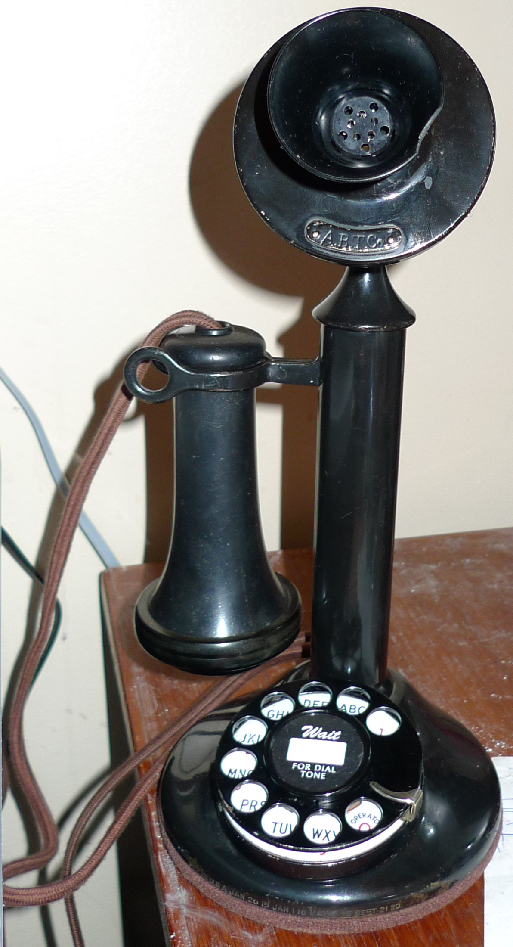
Pitfalls of the disaster
Expecting Food
Expecting Lodging
Poor Communications
This Photo by Unknown Author is licensed under CC BY-SA
Notes:
A few years ago I was involved in screening of workers being sent to Puerto Rico for relief work. After talking to some of these “Voluntassigned” it became apparent that their perception of what they were getting into was almost diametrically opposed to what the situation was in reality.

Slide 27
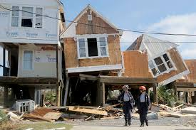
Pitfalls of the disaster
Austere environment
Supply lines weak or not there
Loss of focus
Who?
What?
Duh
When?

Slide 28
Austere Environment
Notes:
What the workers expected is that they would be put up in a hotel while working down there. No chance staying here!

Slide 29
Pitfall of Disaster Response: SCARCITY MENTALITY
“Scarcity captures the mind. The mind orients automatically, powerfully, toward unfulfilled needs. Scarcity is more than just the displeasure of having very little. It changes how we think. It imposes itself on our minds.”
“SCARCITY” Sendhil Mullainathan & Eldar Shafir
Notes:
The austere environment has a way of shaping our thought process. It can change a “can do attitude” into a hopeless and helpless obstacle, causing a lack of focus and increased anxiety and stress. A sense of dread and Awfulness overtakes an otherwise positive attitude and puts the worker at risk for all sorts of negative outcomes. One of the most insidious of all pitfalls is that of a scarcity mentality. HOW DO WE AVOID IT?

Slide 30
Reducing Your Anxiety and Stress
Fight or Flight Response
Cognitive Rehearsal
Notes:
With preparedness comes the ability to pull ourselves out of the dread and awfulness. But these skills must be learned and internalized before the disaster work assignment. Cognitive rehearsal employees the technique of visualization, solving for “what if” scenarios and rehearsing psyco motor skills you may need to use in a given situation. (ever see a diver practice the complexity of a dive before getting on the diving board?)

Slide 31
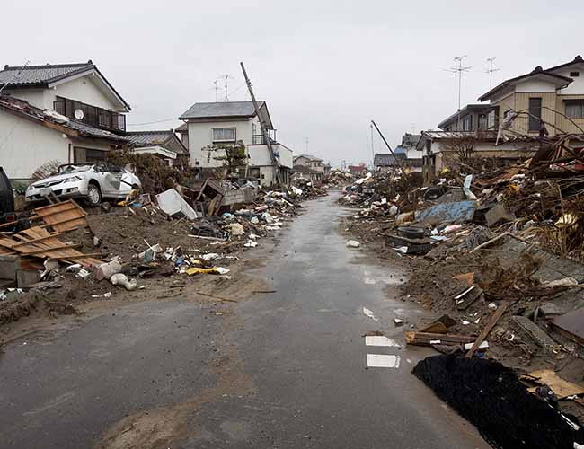
How you handle those memories, as they will sometimes appear later, is critical.
The sights, sounds, smells & impressions you experience at the disaster will form lasting memories
Notes:
PTSD

Slide 32
Learn to De-Stress
External support (Team work)
Psychological resources (mindfulness, visualization, breathing, body awareness)
Coping strategies
~Mihaly Csikszentmihalyi “Flow: the Psychology of Optimal Experience”
Notes:
Just some of the techniques that will be helpful

Slide 33
Your Mind : Cluttered vs Clarity
“46.9 % of our waking hours are spent thinking about something other than what we’re doing,….” (Killingsworth et al, 2010)
This Photo by Unknown Author is licensed under CC BY-NC-ND
Notes:
Keep Your Mind In The Game!

Slide 34
Based on today’s information -- What do you think contributes to a Cluttered Mind?
Lack of information In the absence of information we make up stories in our own mind and then act on them as if they are real
Lack of adequate preparation. Worried about back home, unfinished or unresolved issues
Fear of being tasked beyond our skill set. Poor training
Sensory overload and inability to filter.

Slide 35
Consequences of a Cluttered Mind
Increased incidence of accidents
Decreased productivity
Increased anxiety
Distracted activity
LOSS OF FOCUS

Slide 36
“How you respond to the issue, IS THE ISSUE”
It’s Their Disaster……. Don’t Make It Yours!
Plan Prepare Ready GO!

Slide 37
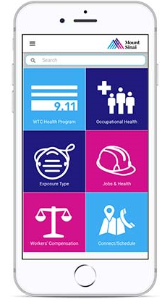
For More Information:
Selikoff Occupational Safety App available through Apple Store and Google Play Store- “Selikoff”
Website: www.mountsinai.org/selikoff
Follow us on Twitter at:@SinaiOccMed
Like us on Facebook: Facebook.com/workerhealth

